Slide 1

Stock Market Prediction
Presented by :
Manyam Sanjay Kumar Reddy (9920004280)
Nimmakayala Vinay Kumar Reddy(9920004374)
Samba Bhavani(9920004298)
Gudied by :
Mrs. R Sumathi , Prof. , Dept. Of CSE , Kalasalingam Academy of Research and Education
Notes:
We designed this template so that each member of the project team has a set of slides with its own theme. Members, here’s how you add a new slide to just your set:
Mark where you want to add the slide: Select an existing one in the Thumbnails pane, click the New Slide button, then choose a layout. The new slide gets the same theme as the other slides in your set.
Careful! Don’t annoy your fellow presenters by accidentally changing their themes. That can happen if you choose a different theme from the Design tab, which changes all of the slides in the presentation to that look.

Slide 2
Topics
Project Description
Objective
Proposed Methodology
Motivation

Slide 3
Topics
Tools and Technologies used
Screenshots
Selected Papers
Conclusion
Refrerences

Slide 4
Stock Market Prediction

Slide 5
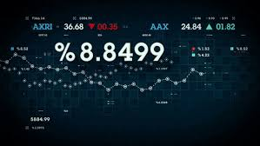
Project Description
We have to predict the share market prices using various algorithms in order to achieve the min to min ahead closing price value.

Slide 6
Objective
Able to Find the best algorithm among various algorithms.
Make the Prediction of share market More user friendly way.
Can find the Closing price history 1 min , 5 min , 10 min ahead.

Slide 7

Motivation
We can use this algorithms to get the accurate prediction of the share prices.
Investors can invest the money in their preferred company using the closing price history.
This analytical data provides the user to study the share market analysis.

Slide 8
Proposed Methodology
Regressions are used to quantify the relationship between one or more predictor variables and a response variable.
More over this Regression helps us to understand how the value of the dependent variable is changing to the independent variables.
This is an Supervised Learning Technique which helps in finding the correlation between variables and enables to predict the continuous output variable based.

Slide 9
Proposed Methodology (Contd..)
Algorithms used :
1. Linear Regression
2. Lasso Regression
3. Polynomial Regression
4. Ridge Regression

Slide 10
Tools and Technologies used
DATASET
The dataset contains the information about the Tata company Stock prices from 2013 to 2018. It has over 1234 (rows) and 6 columns :
Close – Closing price of the day
Low – Lowest price reached at that day
High – Highest price reached at the day
Open – Opening price of the day
Turnover – Total turnover of the company in lacs.

Slide 11

Tools and Technologies used ( Contd..)
IDE ( PYTHON)
Platform ( Google Colab )
Google colab is an Extraordinary platform for machine learning projects.

Slide 12
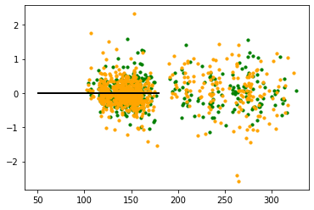
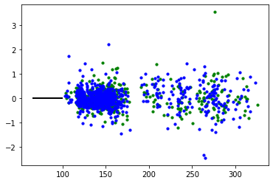
Sample Screenshots
Linear Regression Graph
Polynomial Regression Graph

Slide 13
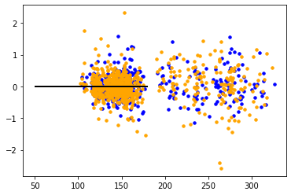
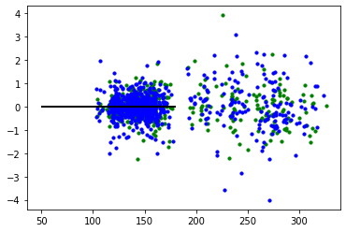
Ridge Regression Graph
Lasso Regression Graph

Slide 14
Selected Papers
Google Drive Link of the selected papers : https://drive.google.com/drive/folders/109DkXl63dhw56SnMr3dpK0CqqGXYWmhW?usp=sharing
1. Stock Closing Price Prediction using Machine Learning Techniques
2. Stock Market prediction on High frequency data using Long-Short Term Memory
3. Stock Price Prediction Using Long Short Term Memory

Slide 15
Conclusion
The Results of the comparison among the various algorithms shows the Ridge Regression has a better prediction accuracy than the other three algorithms we have used.
This model is based on the Various algorithms using the data from Kaggle
Finally we have predicted the closing price history a min ahead.
More the Variance value more is the accuracy.
Using the Ridge Regression we predicted the share price accurately.

Slide 16
References
International Conference on Computational Intelligence and Data Science (ICCIDS 2019) Stock Closing Price Prediction using Machine Learning Techniques Mehar Vijh, Deeksha Chandola, Vinay Anand Tikkiwal, Arun Kumar.
Pascanu, Razvan, Tomas Mikolov, and Yoshua Bengio. “On the difficulty of training recurrent neural networks.” International Conference on Machine Learning. 2013.
Stock Price Prediction Using Long Short Term Memory Raghav Nandakumar, Uttamraj K R, Vishal R, Y V Lokeswar

